Slide 1

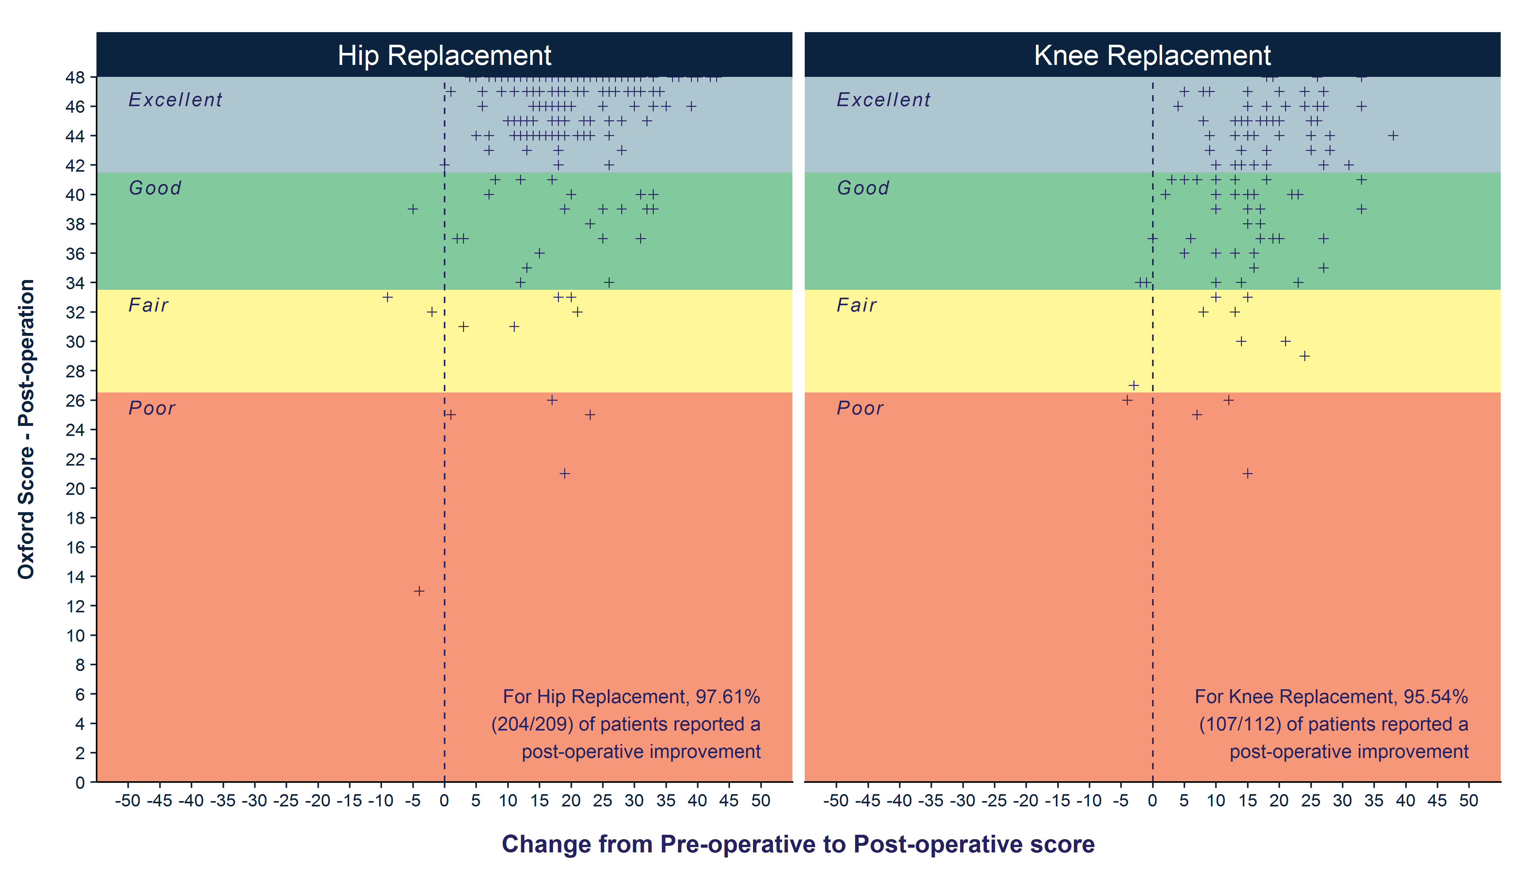
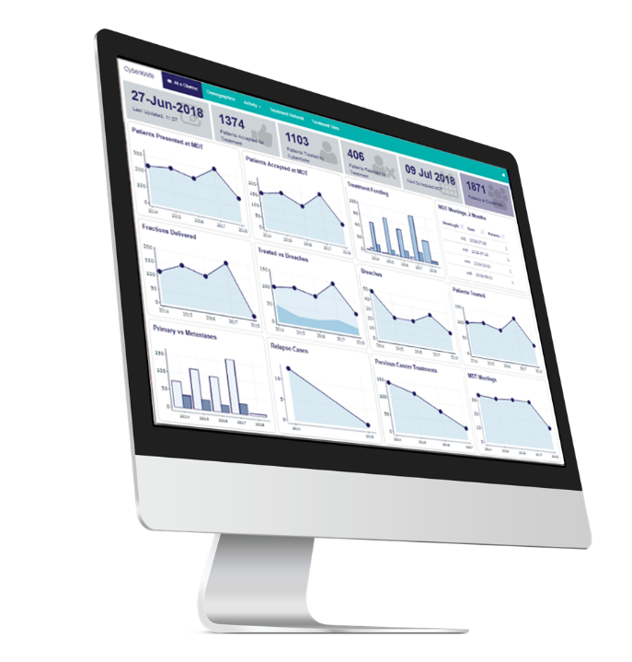

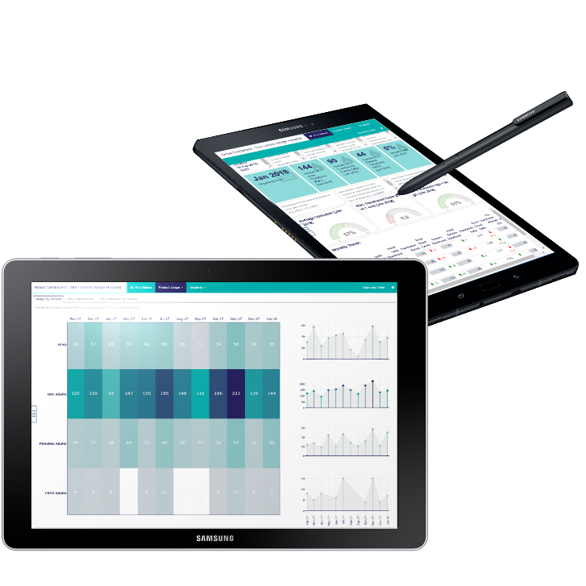
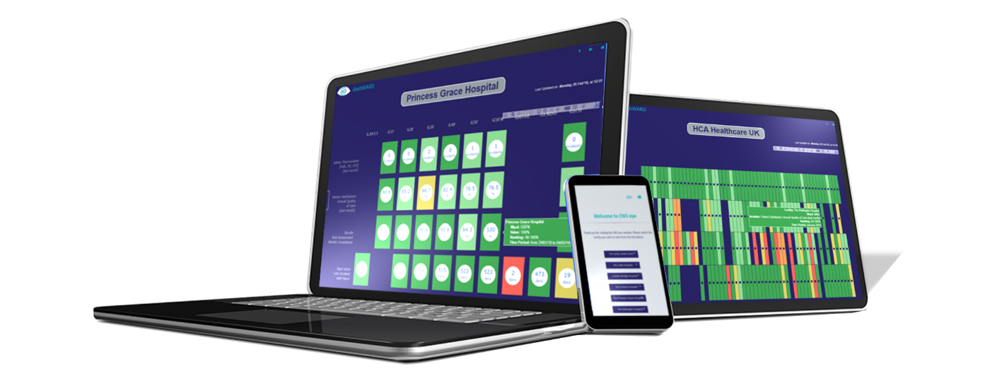
Clinical Informatics
How to automate jobs in R and forget about it..
..sort of
Daria.Cosentino@hcahealthcare.co.uk
Clinical.Informatics@hcahealthcare.co.uk

Slide 2
Agenda
Introduction
Our infrastructure
A brief history of reporting and its challenges
A whole “new” world: R and Task Scheduler
A whole “new” challenge
..and they lived happily ever after
1
2
3
4
5
6

Slide 3

Who we are
Director, Clinical Information & Analytics
Tim
Clinical Informatics Manager
Daria
Senior Clinical Analyst
Chiara
André
Jenny
Anna Maria
Clinical Analysts & NHS trainee scientist
Vacant
Trainee

Slide 4






Our infrastructure
One
data is entered into clinical systems
Two
ITG extract this data…
Three
…and deliver it daily to our server
Four
our robots build refreshed analytics several times a day
PAS
(NoSQL)
Data Repository
(SQL)
Server 1
Main DB
(SQL)
Analyst PC
R Studio
meditech
Other clinical systems:
Vitals, Incidents, ITU, Registries, etc.
(SQL)
Server 2
DB Mirror
Web Server
R Studio
Task Automation
icip / icca
Automated outputs
Web & PDF
nerveCentre
ITG
Clinical Informatics
etc.

Slide 5








Our toolchain
One
data is entered into clinical systems
Two
it&g extract this data…
Three
…and deliver it daily to our server
Four
our robots build refreshed analytics several times a day
PAS
(NoSQL)
Data Repository
(SQL)
Server 1
Main DB
(SQL)
Analyst PC
R Studio
meditech
library(ClinInf)
Other clinical systems:
Vitals, Incidents, ITU, Registries, etc.
(SQL)
Server 2
DB Mirror
Web Server
R Studio
Task Automation
icip / icca
Automated outputs
Web & PDF
library(rmarkdown)
…
library(caret)
library(e1071)
library(C50)
library(MLR)
nerveCentre
IT&G
Clinical Informatics
etc.
Notes:
Better coding with tidyverse (stringr, forcats, rlang, magrittr)
“Collection of R packages designed for data science, sharing an underlying design philosophy, grammar, and data structures”

Slide 6





A brief history of reporting
 | PROS | CONS
 |  | Prone to errors Time consuming Frustrating – Excel crashing.. Poor visualisations Report can be modified by users Data are not live
 | Less Prone to errors Less Time consuming | UX issues Updates to the workbook would require sending a new file to the users Version Control
 | Parametric Great versatility Version Control Great visualisations with ggplot2 Allows other forms of output | Distribution still an issue Not live as soon as it has been generated (healthcare data is a living organism - end users disputing not correct figures)
 | We control the output – you can delete the html if it’s wrong Better UX | The jobs still need to be triggered manually from Rstudio to refresh the output
ctrl+C
ctrl+V
Excel Connections to SQL
R generated reports
R html reports

Slide 7
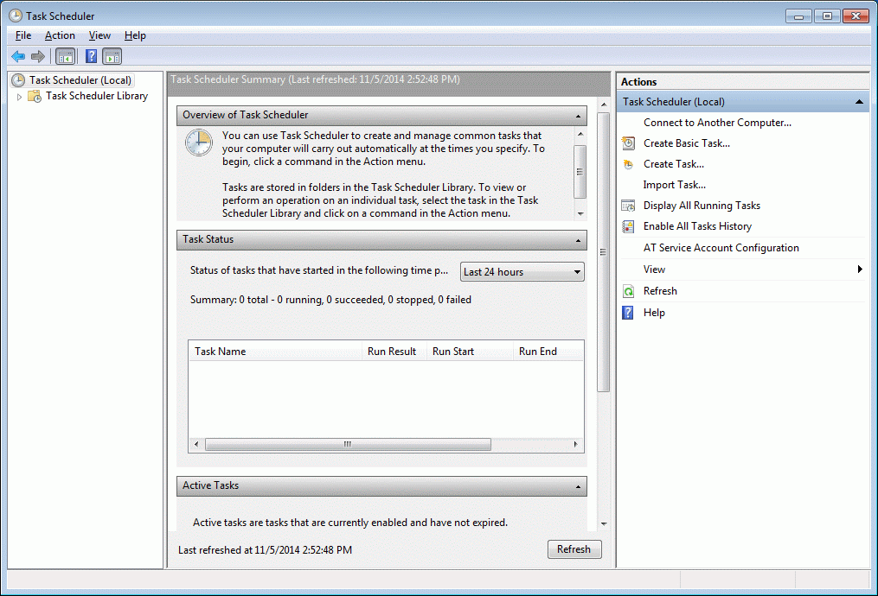
A whole new world
Task Scheduler is a component of Microsoft Windows that provides the ability to schedule the launch of programs or scripts at pre-defined times or after specified time intervals.
It was first introduced for Windows 95 and since then it has been part of any following Windows OS.
The Start a Program function within task scheduler work with .exe files, PowerShell or Command Prompt commands.
We generally use Command Prompt commands saved in a Batch File since it is a convenient option to automate routines.
A Batch File is a special kind of text file that typically has a .bat extension, which can include one or multiple commands that Command Prompt can understand and run in sequence to perform various actions.
Notes:
Demo TASK SCHEDULER

Slide 8
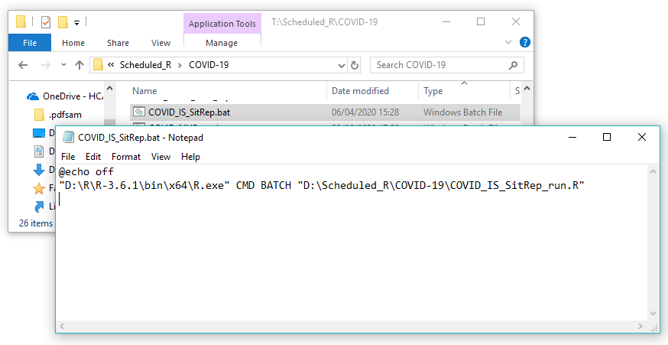
A whole new world
To create a batch file you only need to:
Open a text editor
Type the command to be run
Save As .bat
@echo off: disables the display prompt – turns command echoing off
“D:\R\R-3.6.1\bin\x64\R.exe”: specifies the Program to be started (just locate on your PC the R.exe file)
CMD BATCH: This batch command invokes another instance of command prompt
“D:\Scheduled_R\....\COVID_IS_SitRep_run.R”: path to the R script that will be executed by the program R.exe
Alternatively, you can use the simplified library(taskscheduleR)
Notes:
Demo Job run on TASK SCHEDULER

Slide 9
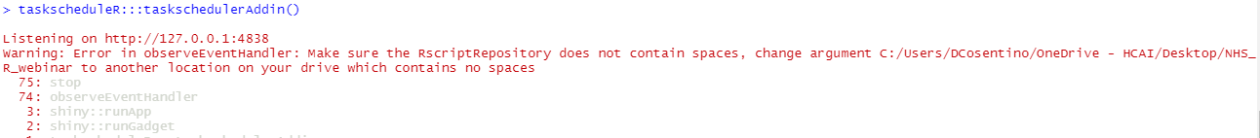
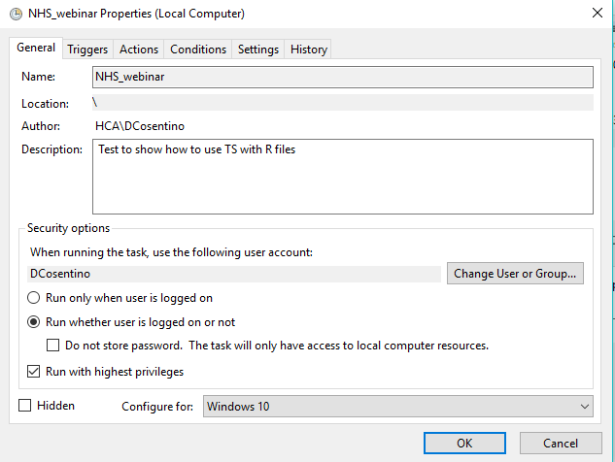
A whole new world
QUICK TROUBLESHOOTING :
When using the library(taskscheduleR) Add-In make sure to use directories without white spaces or it’ll throw an error
When using Task Scheduler + .bat files, tick the option:
“Run whether user is logged on or not” and if you are having folders permission
issues (error 0x2), tick “Run with the highest privileges”
If you want to render a html page (with flexdashboard or rmarkdown) you most likely
will have to specify the location of PANDOC (which is called only from the IDE
Rstudio, not from R.exe) at the beginning of your Rscript:
Sys.setenv(RSTUDIO_PANDOC="D:\\R\\RStudio\\bin\\Pandoc")

Slide 10


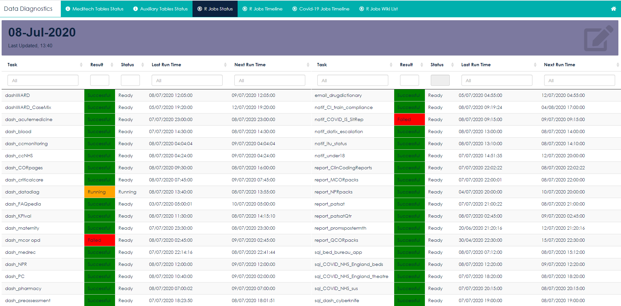
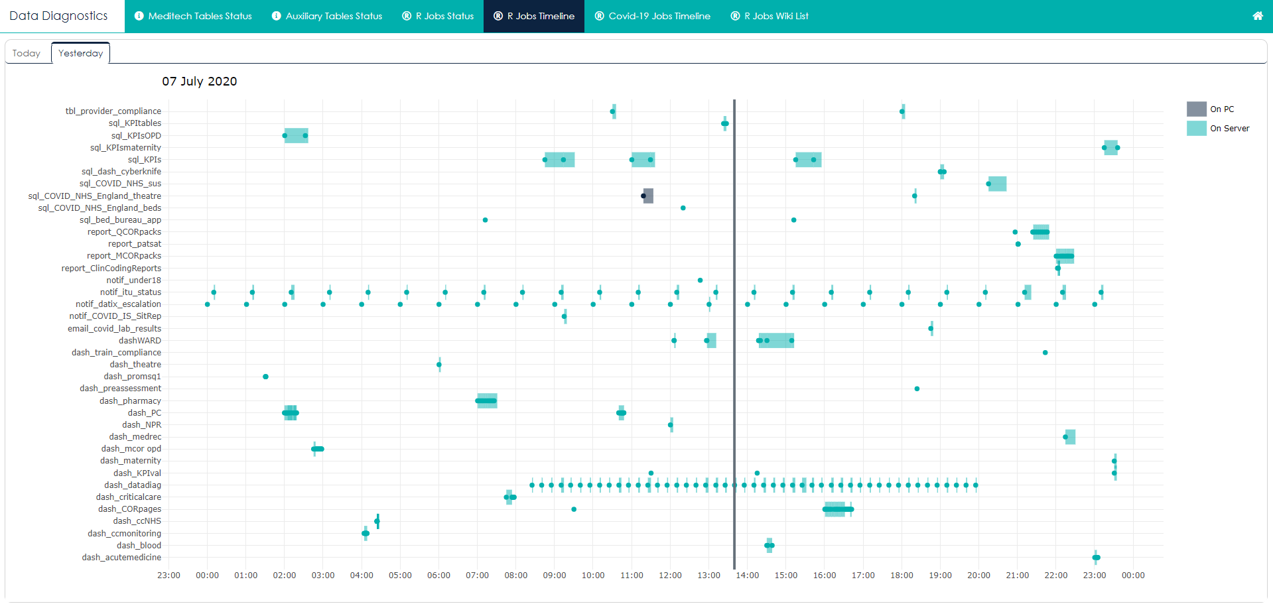
A whole
new challenge
Now that we can automate all the
Jobs we want… where is the limit?
The main risk is JOB Failure..
And we don’t want to receive the
news that a job has failed by the
end-users themselves!
Diagnostics Dashboard
“Jobs Log” Table
Notes:
DEMO Data Diagnostic dashboard and library(tasckscheduleR) + Adds-In?
install.packages("taskscheduleR")
library(taskscheduleR)
#get a df of all tasks
tasks <- taskscheduleR::taskscheduler_ls()

Slide 11
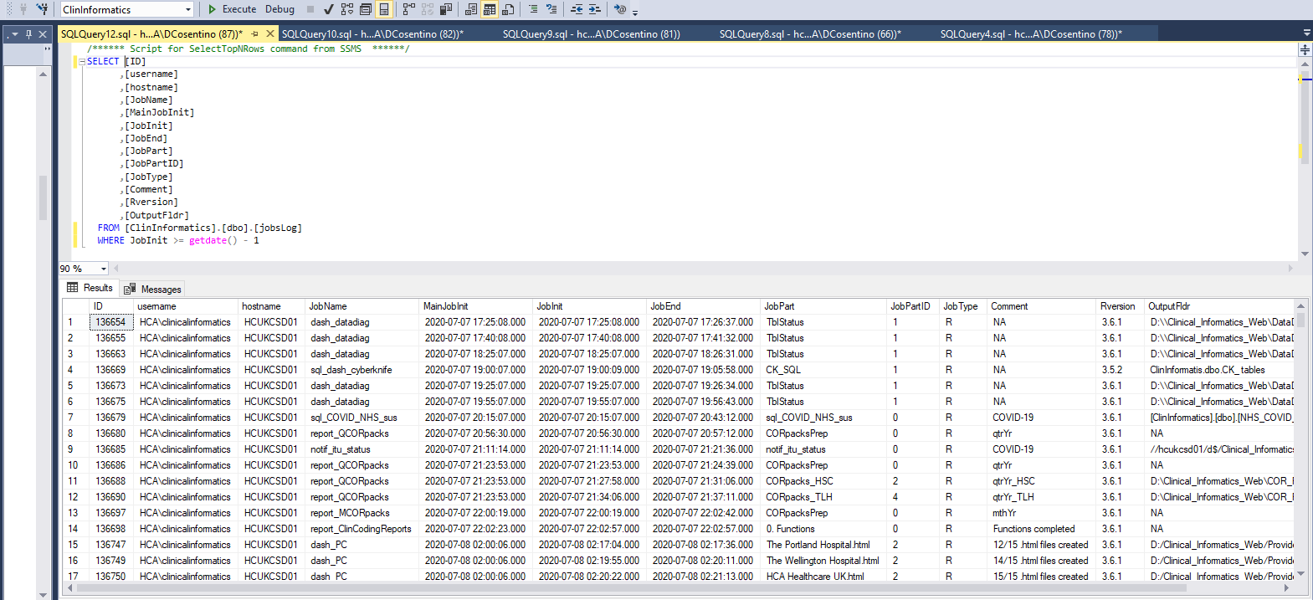
A whole
new challenge
Now that we can automate all the
Jobs we want… where is the limit?
The main risk is JOB Failure..
And we don’t want to receive the
news that a job has failed by the
end-users themselves!
Diagnostics Dashboard
“Jobs Log” Table
Notes:
jobsLog Documentation from R

Slide 12
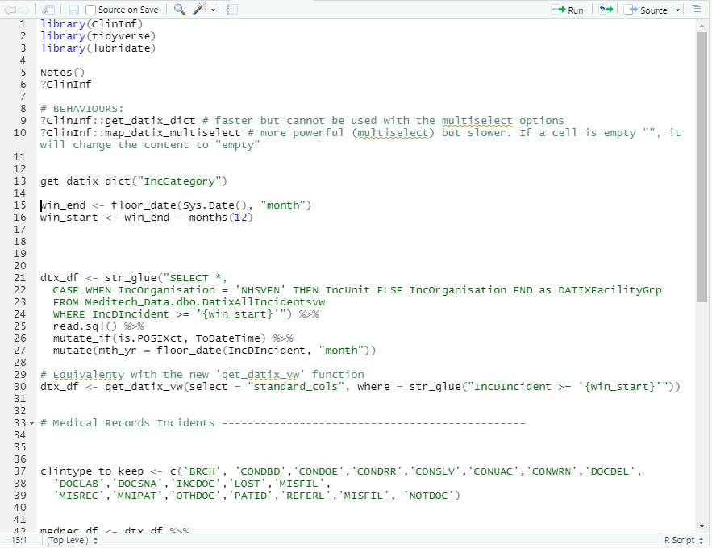
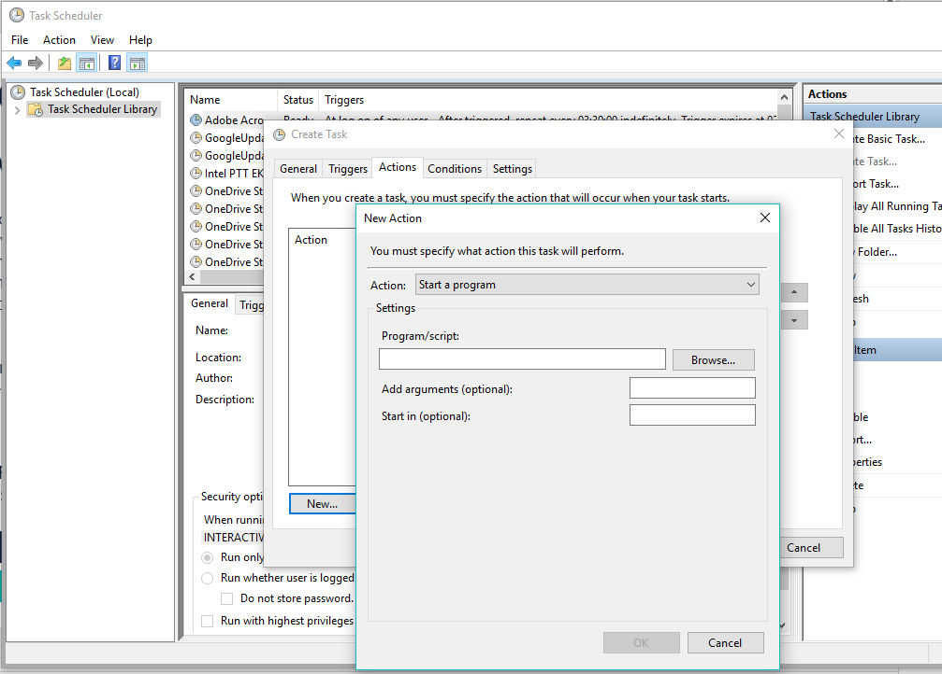
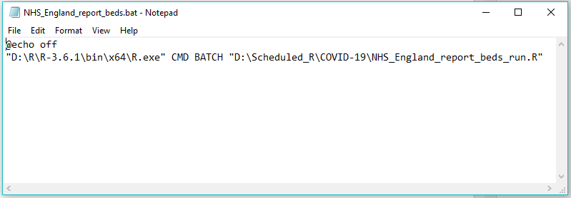
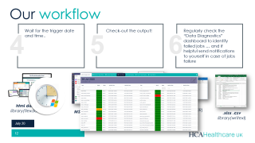
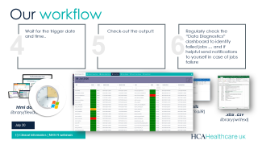
Our workflow
Create the R script you want to be run from Task-Scheduler
Create the .bat file you want Task-Scheduler to run, specifying the R.exe to use and the path to the Rscript
Create a new Task in Task scheduler, specifying the Action and the Trigger
1
2
3

Slide 13
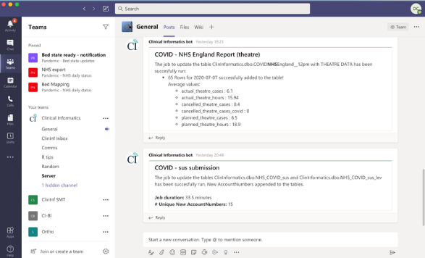
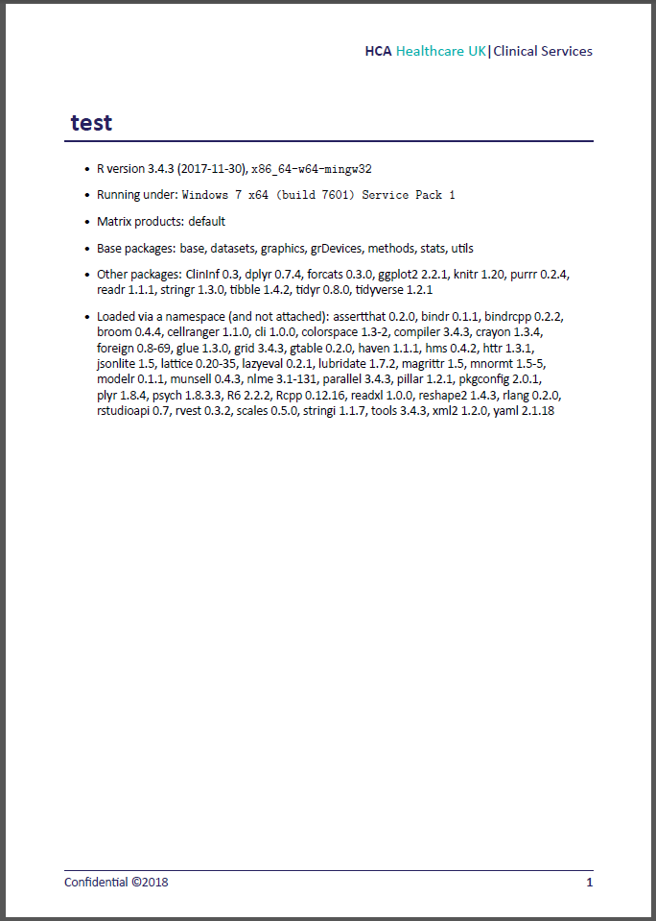
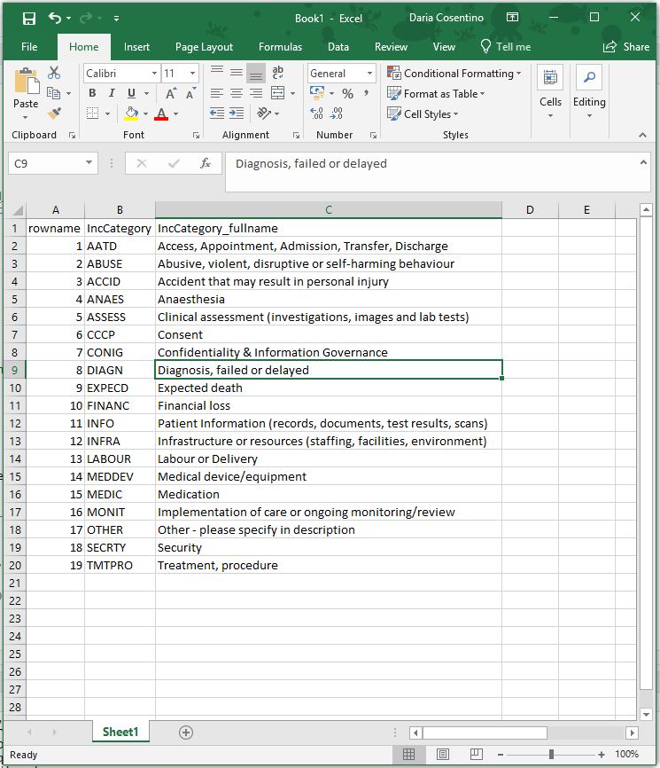
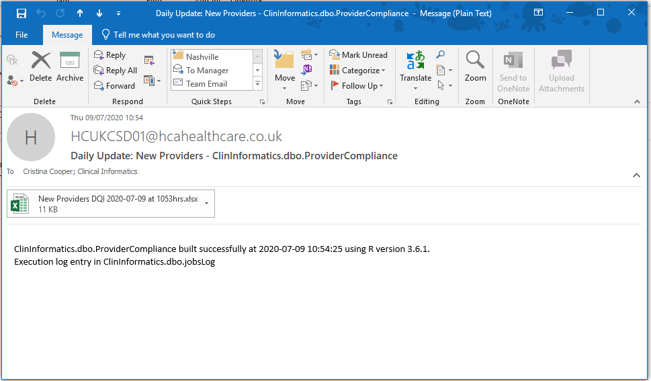
Our workflow
Wait for the trigger date and time..
Check-out the output!
Regularly check the “Data Diagnostics” dashboard to identify failed jobs … and if helpful send notifications to yourself in case of jobs failure
4
5
6
html dashboards
library(flexdashboard)
Emails
library(mailR)
MS Teams notifications
library(teamr)
.xlsx .csv
library(writexl)
LateX PDFs
library(knitr)

Slide 14

242 Marylebone Road
London, NW1 6JL
www.hcahealthcare.co.uk
Daria.Cosentino@hcahealthcare.co.uk
Clinical.Informatics@hcahealthcare.co.uk

